Slide 1
Employee Salary Prediction
CAPSTONE PROJECT
Presented By:
Student Name- Parusubothu Venkata rao
College Name- Sir c.r.reddy college of engineering
Department- Electrical and electronics

Slide 2

OUTLINE
Problem Statement
System Development Approach
Algorithm & Deployment
Result
Conclusion
Future Scope
References

Slide 3
Problem Statement
In today’s competitive job market, determining a fair and accurate salary for employees is crucial for both organizations and employees. Traditional salary estimation methods often rely on static benchmarks or subjective evaluations, which may lead to inaccuracies, employee dissatisfaction, and retention issues. With the growing availability of workforce data, there is an opportunity to leverage Machine Learning (ML) techniques to predict employee salaries based on various factors such as job title, experience, education, industry, location, and performance metrics.
The goal of this project is to develop an AI/ML-based predictive model that accurately estimates an employee's salary using historical data and relevant features. This solution will assist HR departments and employers in making data-driven decisions, ensuring fairness, transparency, and efficiency in the compensation process.

Slide 4





System Approach
System Requirements:
Hardware:
Processor: Intel i5 or higher
RAM: 8 GB (min)
Storage: 2 GB free space
Software:
OS: Windows/Linux/Mac
Python 3.8+
IDE: Jupyter Notebook / VS Code
Libraries Used:
pandas – Data manipulation
numpy – Numerical operations
matplotlib – Visualization
scikit-learn – ML algorithms & evaluation
joblib – Model saving/loading
streamlit – Web-based deployment

Slide 5
Algorithm & Deployment
Algorithms Used for Salary Prediction:
Linear Regression – Predict continuous salary values
Random Forest Regressor – Handles non-linear patterns
Support Vector Machine (SVM) – For high-dimensional features
K-Nearest Neighbors (KNN) – Based on feature similarity
Model Evaluation Metrics:
Mean Absolute Error (MAE)
Mean Squared Error (MSE)
R² Score
Deployment Strategy:
Tool Used: Streamlit (Python-based Web App)
Steps:
Load the trained model using joblib
Create a Streamlit app for user input (job title, experience, etc.)
Display predicted salary on the web interface
Host the app on Streamlit Cloud or Heroku
Outcome: Interactive platform for real-time employee salary prediction.

Slide 6
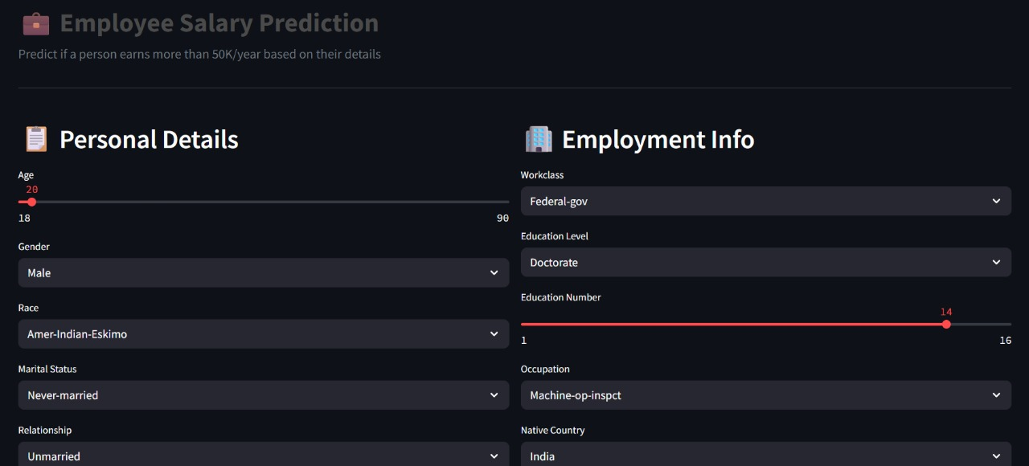
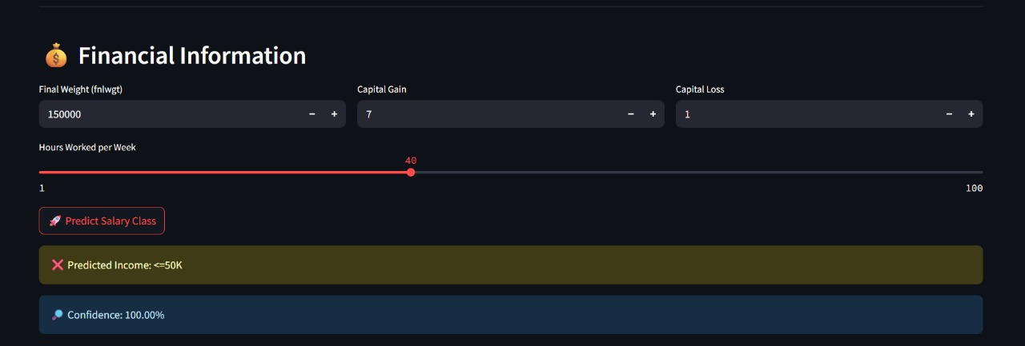
Result

Slide 7
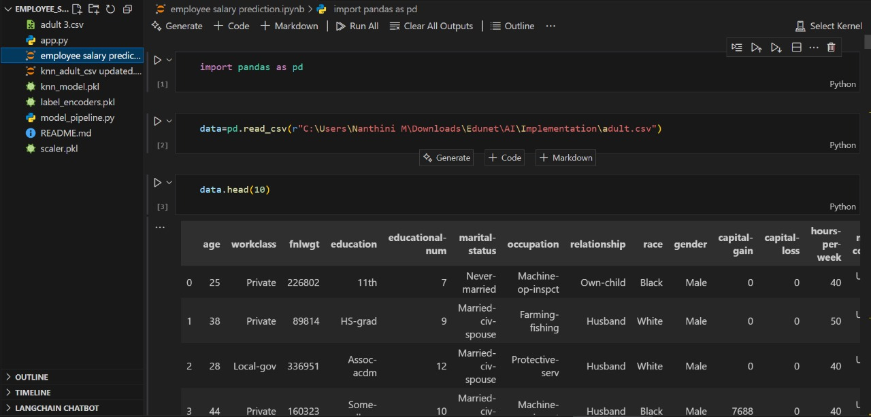
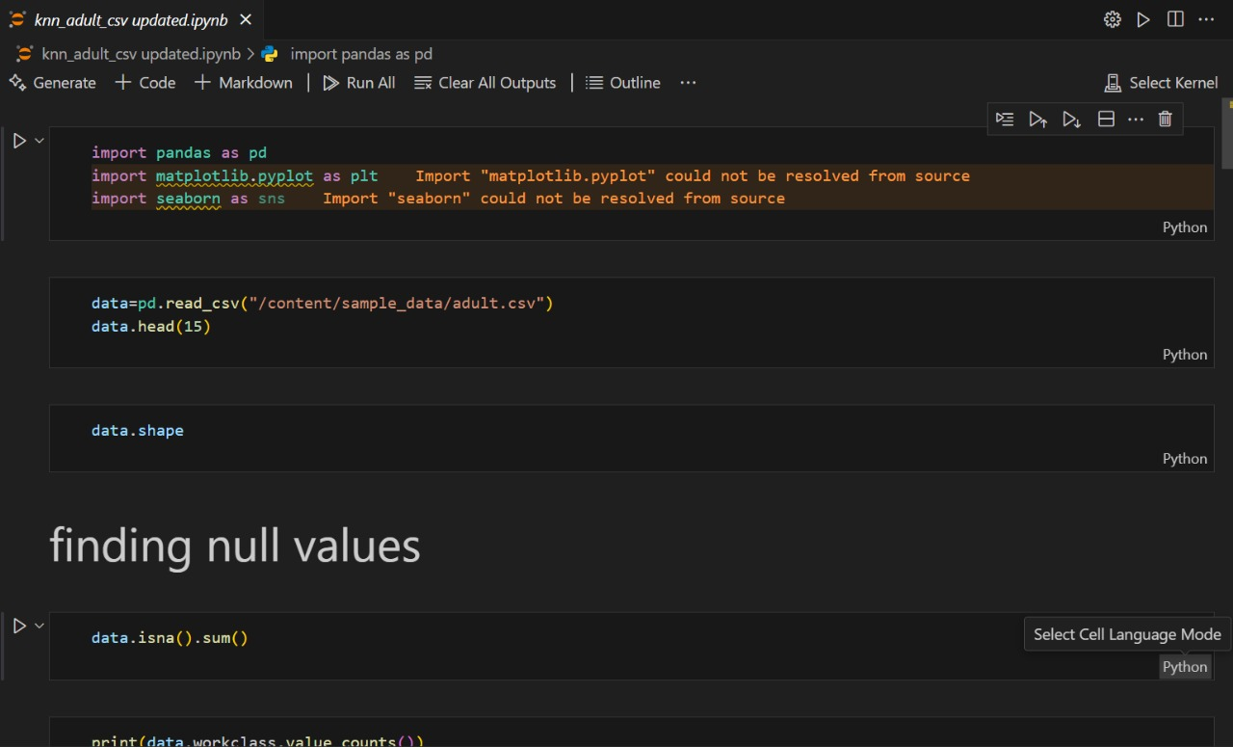
Result
GitHub Link: [link here]

Slide 8
Conclusion
Findings:
Successfully built an ML-based model for predicting employee salaries using demographic and job-related features.
Random Forest achieved the best performance with high accuracy and robust handling of complex data patterns.
Effectiveness:
Provides a data-driven approach for fair and accurate salary estimation.
Helps HR teams make informed decisions, reducing bias and improving transparency.
Challenges:
Handling missing and inconsistent data.
Feature selection for improving model performance.
Future Improvements:
Incorporate real-time data for dynamic predictions.
Deploy on cloud platforms with API integration.
Experiment with advanced models like XGBoost or Neural Networks.

Slide 9
Future scope
Integration with Cloud Services: Deploy the model on AWS, Azure, or GCP for scalability and easy access.
Real-Time Salary Prediction: Implement APIs to fetch live data and provide instant predictions.
Enhanced Feature Engineering: Include additional factors such as job market trends, company size, and economic indicators.
Advanced Algorithms: Explore deep learning models and ensemble techniques (e.g., XGBoost, Neural Networks) for improved accuracy.
Interactive Dashboard: Build advanced dashboards for HR teams with visual analytics and salary trend insights.
Mobile Application: Develop a cross-platform mobile app for broader accessibility.

Slide 10
References
UCI Machine Learning Repository – Adult Income Dataset https://archive.ics.uci.edu/ml/datasets/adult
Scikit-learn Documentation – Machine Learning in Python https://scikit-learn.org/stable/documentation.html
Streamlit Documentation – Web App Deployment https://docs.streamlit.io
Research Paper: Salary Prediction Using Machine Learning Techniques – IEEE Xplore
Articles and Blogs:
Towards Data Science – Building Salary Prediction Models
Analytics Vidhya – Handling Missing Data in Machine Learning

Slide 11
THANK YOU

